Slide 1

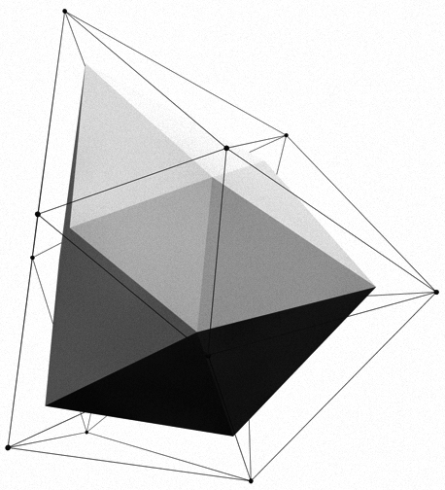


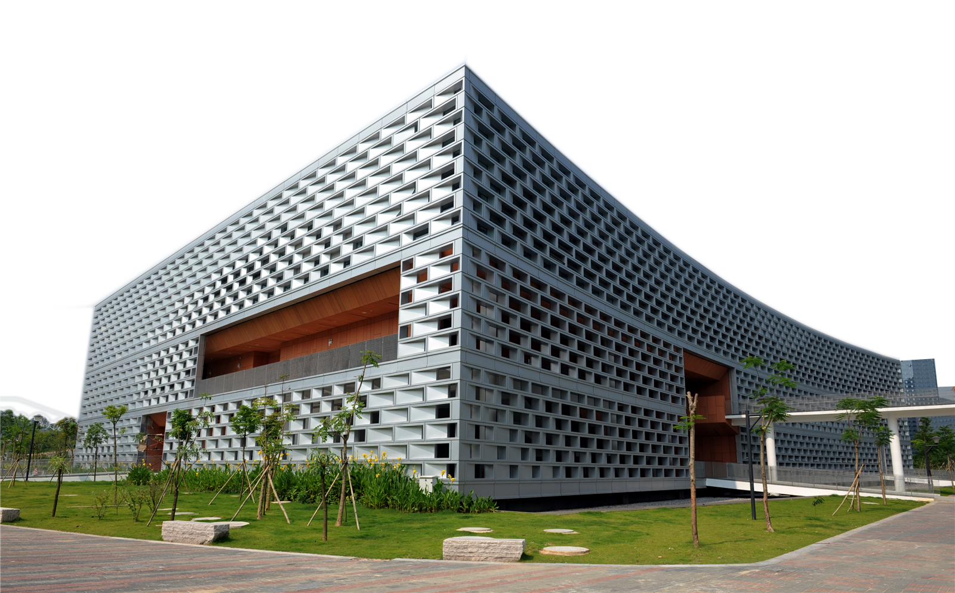
SUSTechMajiang
卞证 Zheng Bian 向昕昊Xinhao Xiang
徐天元 Tianyuan Xv 林傲 Ao lin 孙斌贤 Bingxian Sun

Slide 2
Let’s first enjoy the game!

Slide 3

Timeline
preparatory phase:
(before the opening report 2019.10.9)
1
game rule and APIs
Art materials collection
Established a network frame
> Communication between Client and server
> Interactive between server and database
> Send complete data at the end of commu
> Sticky package, half package
prophase:
(before 11.21)
2
Implement the game logic with OO pattern
so that the whole game can run.
anaphase:
(before 12.26）
3
Combine the PVP mode and PVE mode
Focus on better UI
Combine with more arts and music materials
Shore + chat mode
Do some refactoring

Slide 4
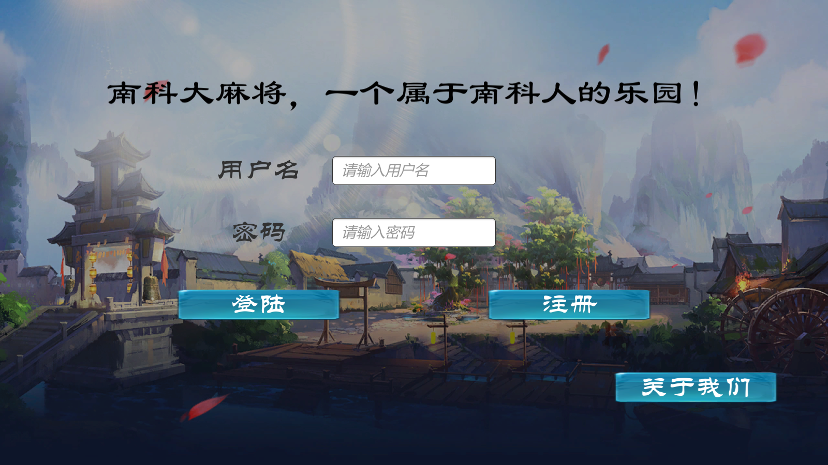
An overview of our project:
MANY
FAST
GREAT
NOT ECONOMIC

Slide 5
MANY
Many functions we have implemented
Many documents we have written
Many plans we have made
Many things we have learnt

Slide 6
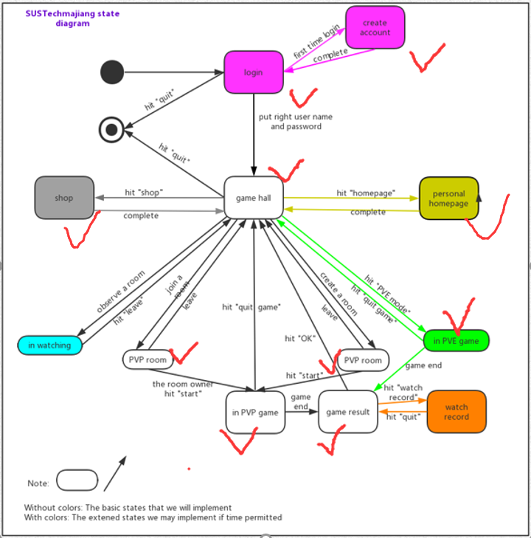
Many functions we have implemented
New function:
SUSTech special skills
Donate function

Slide 7
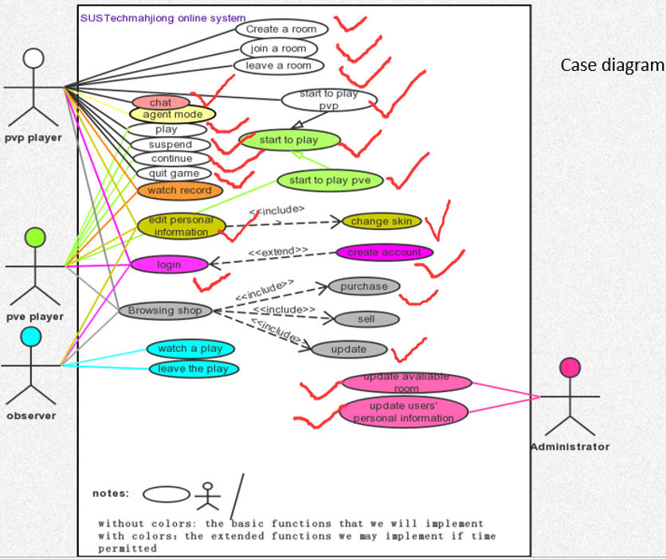
Many functions we have implemented
New function:
SUSTech special skills
Donate function

Slide 8
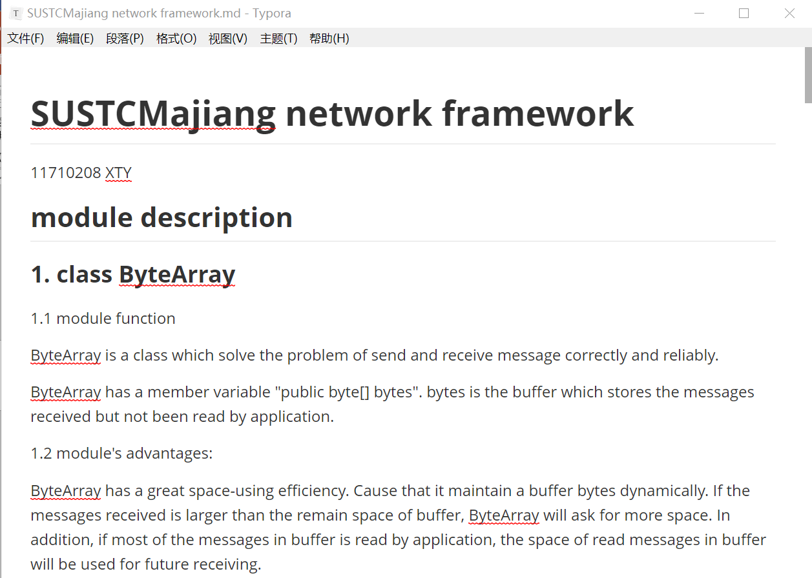
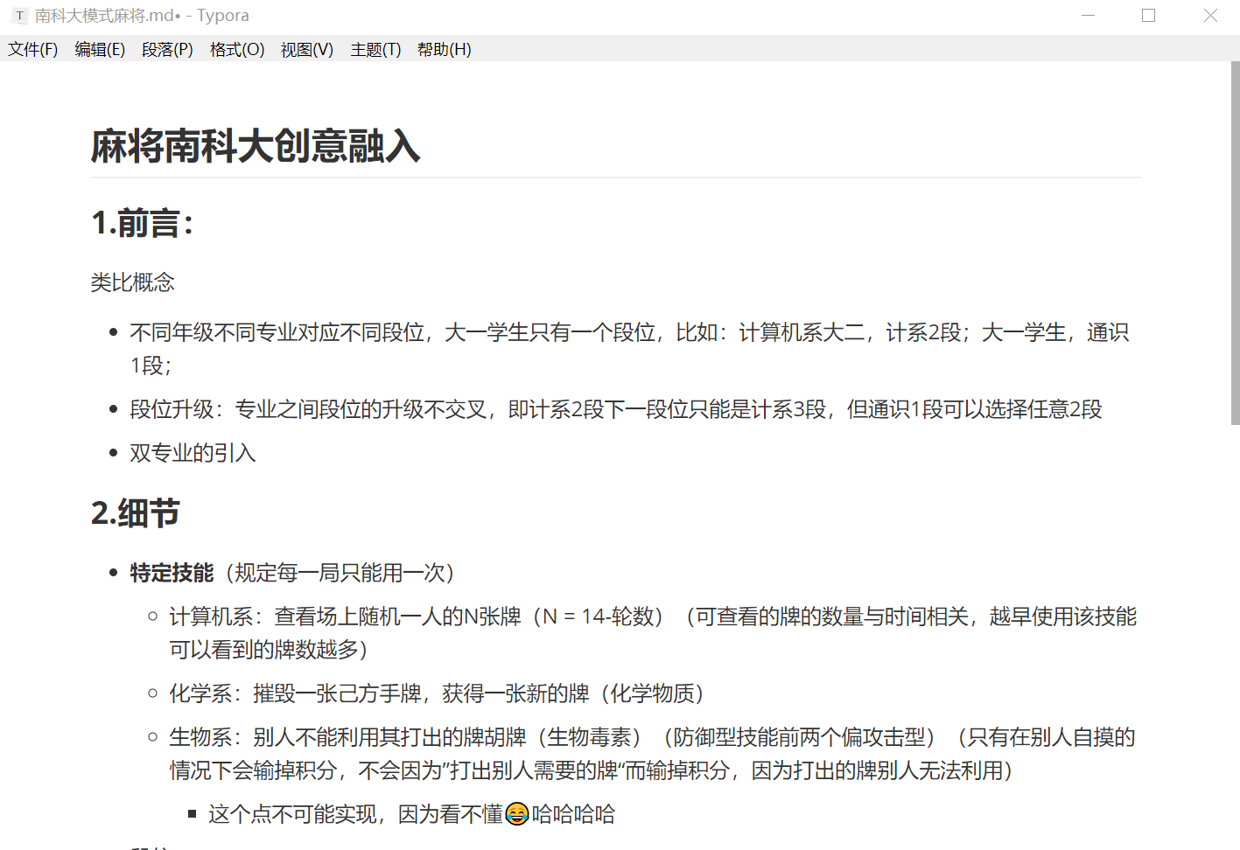
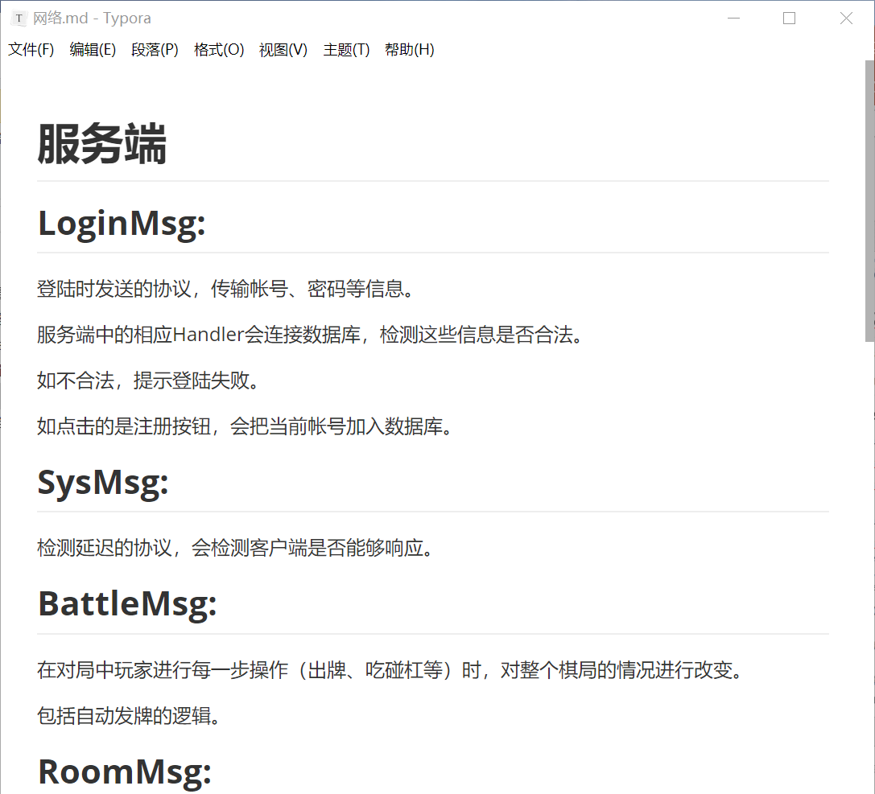
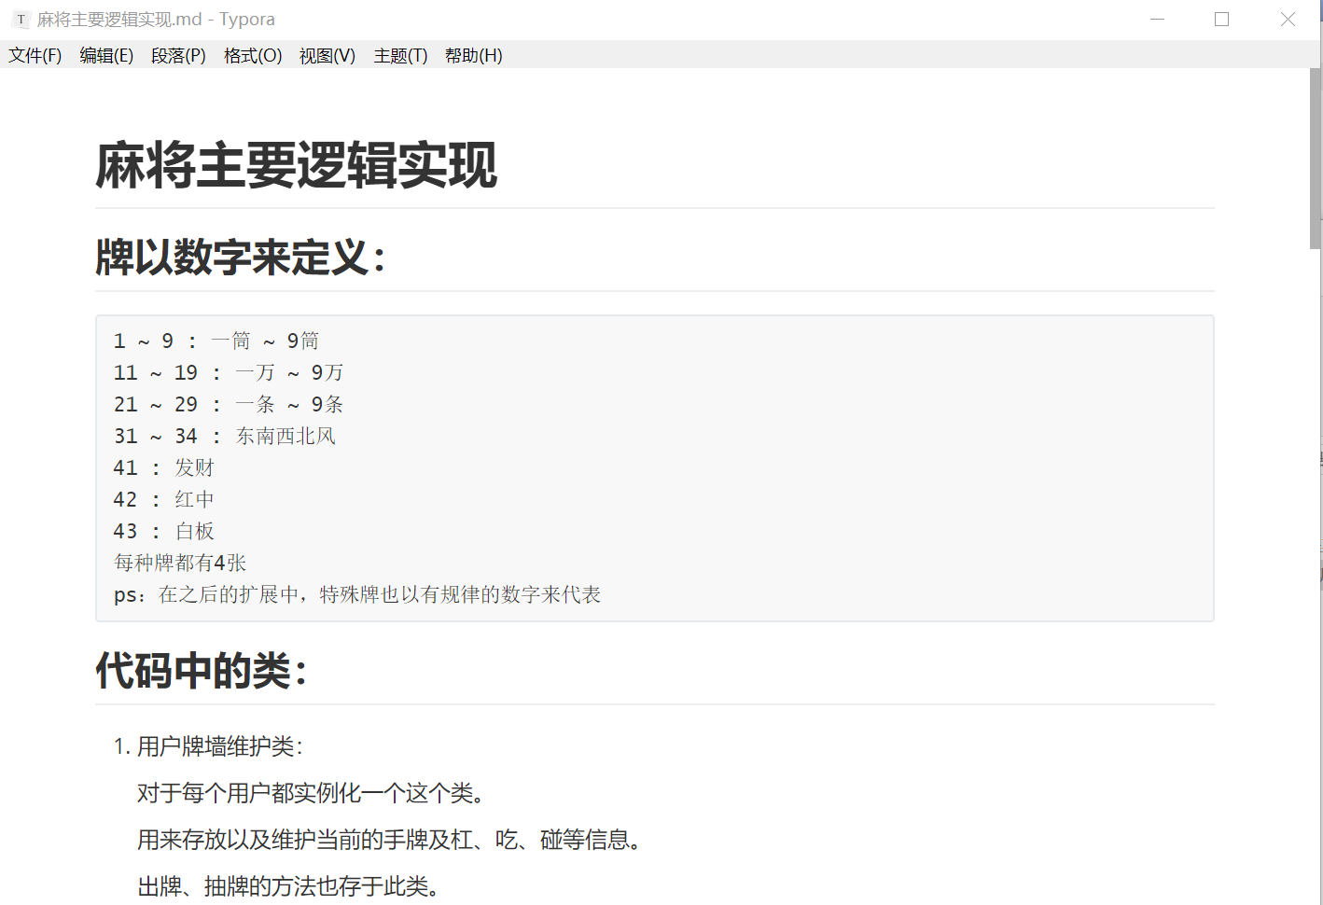
Many documents we have written

Slide 9
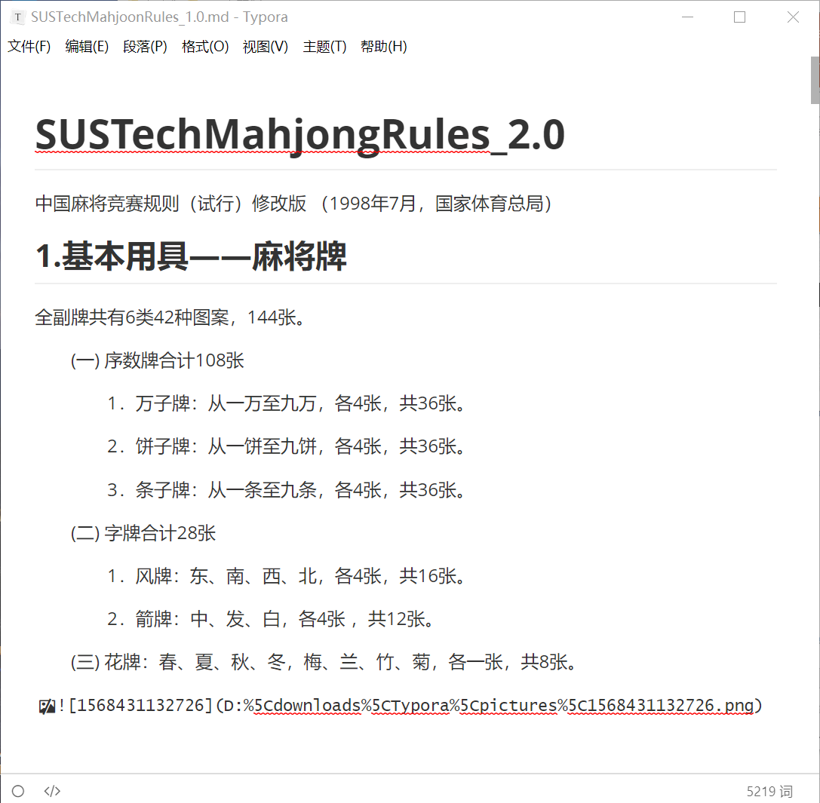
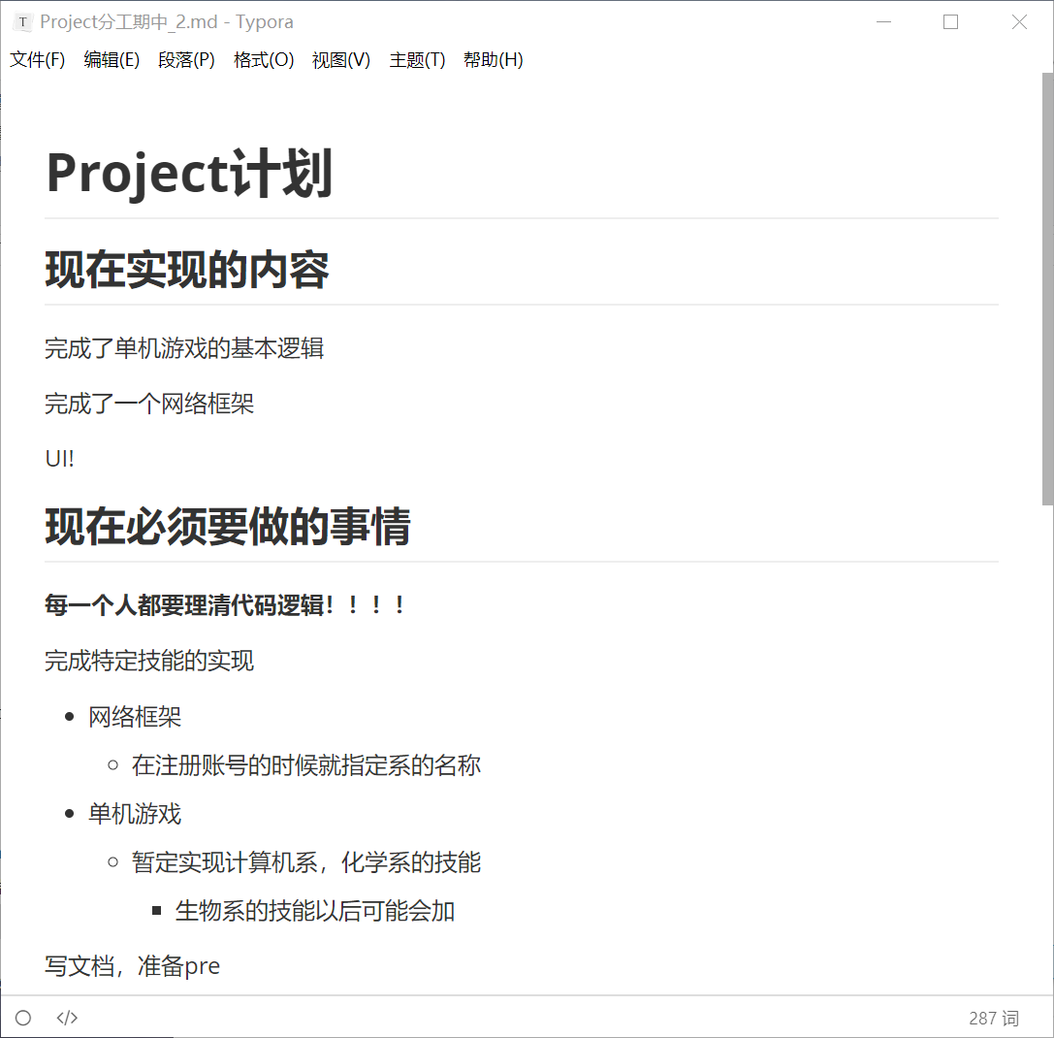
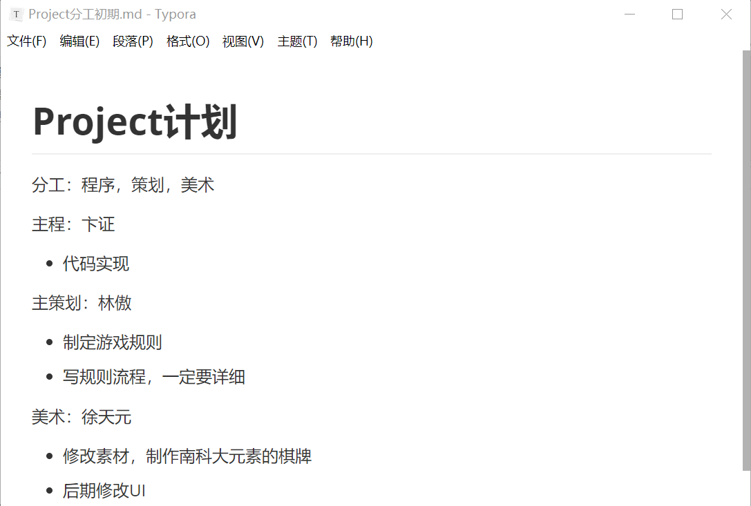
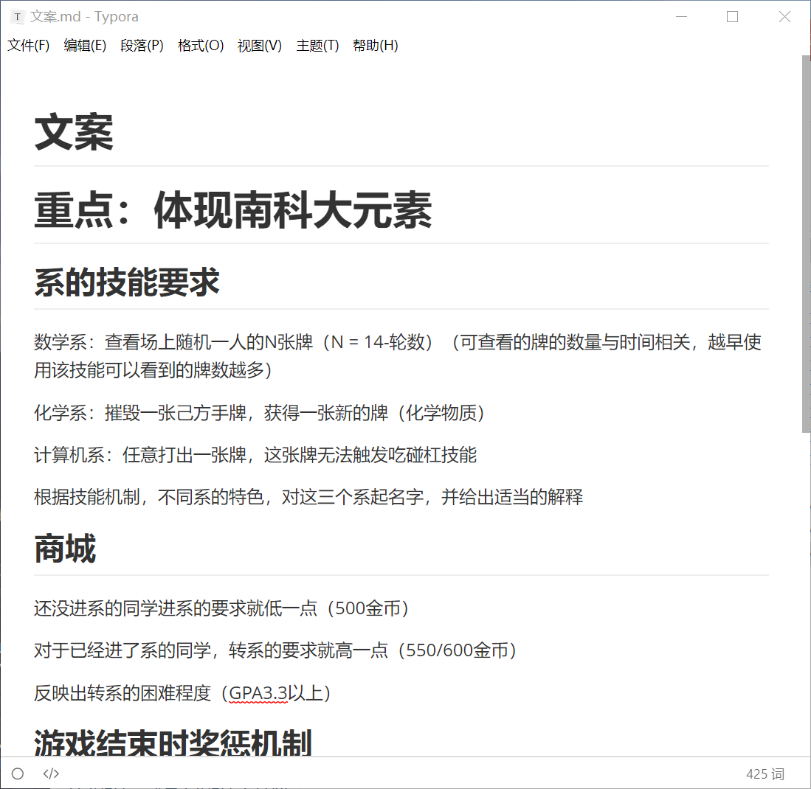
Many plans we have made

Slide 10
Many things we have learnt
How to use Unity to develop a game
How to construct the server part and client part respectively
How to do testing for a game
How to use OO design pattern and refactor methods to make codes beautiful
How to play Majiang ……

Slide 11
FAST
Finish the task on time according to the plan
Overfulfilled our teacher's advice

Slide 12
Finish the task on time according to the plan
Timeline
preparatory phase:
(before the opening report 2019.10.9)
1
game rule and APIs
Art materials collection
Established a network frame
> Communication between Client and server
> Interactive between server and database
> Send complete data at the end of commu
> Sticky package, half package
prophase:
(before 11.21)
2
Implement the game logic with OO pattern
so that the whole game can run.
anaphase:
(before 12.21）
3
Combine the PVP mode and PVE mode
Focus on better UI
Combine with more arts and music materials
Shore + chat mode
Do some refactoring

Slide 13
Overfulfilled our teacher's advice
A player’s story:
> At first a player do not have any department skills
> Earn money by playing
> Having enough money, he can by a department skill
> He can by more department skills, although needs more than the normal price

Slide 14
Overfulfilled our teacher's advice
Department skills:
Department of Math:(寄生种子)
The number of cards we can see = 14-x (number of rounds)
Department of Chemistry:(丹珠回春)
Throw one more card and take one more card
Department of Computer Science:(大佬讲话)
Can throw a card which cannot be Chi, Peng, Gang, Hu or any other operation for other players.

Slide 15
GREAT
GREAT structure of our code

Slide 16
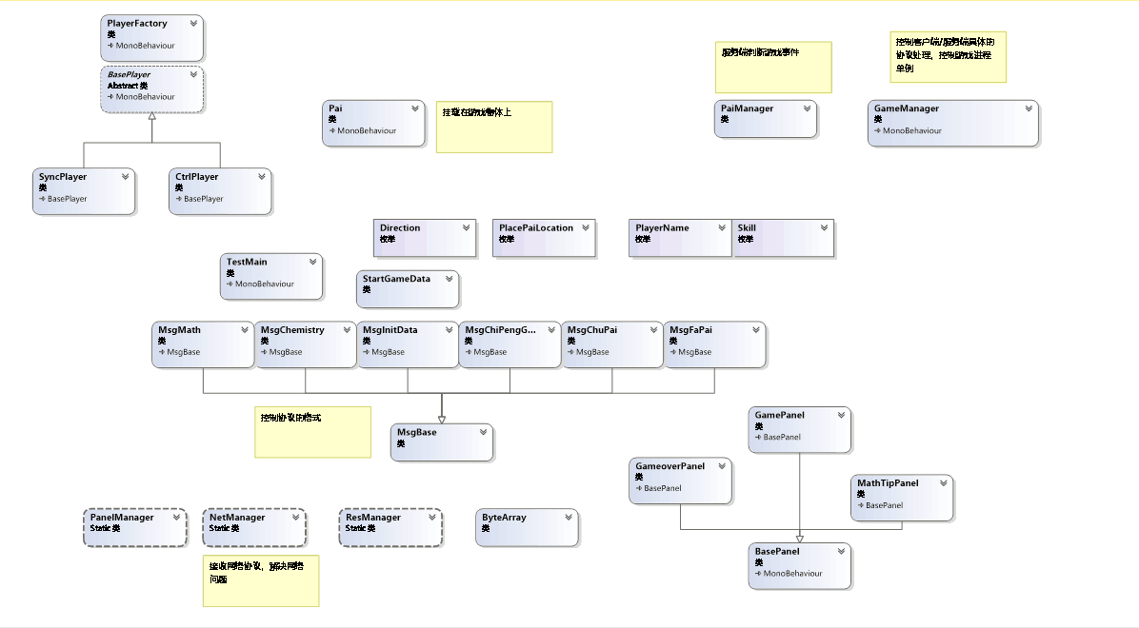
The class diagram generated based on the real code ---by midterm
GREAT structure of our code

Slide 17
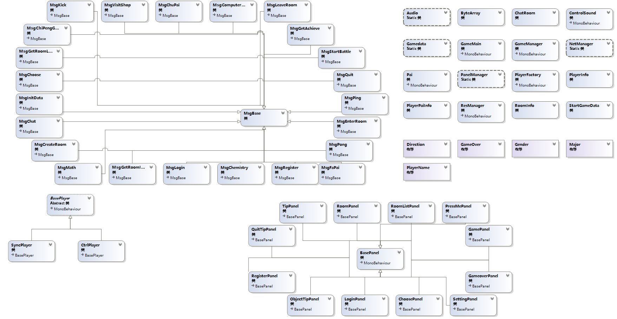
Now…

Slide 18
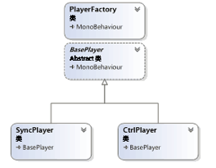
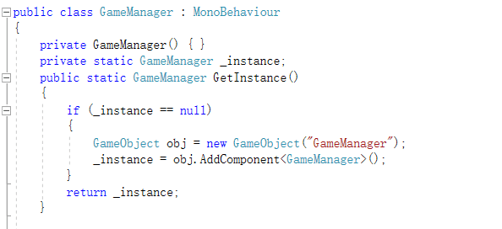
The design patterns we use
Factory pattern
Singleton Pattern

Slide 19
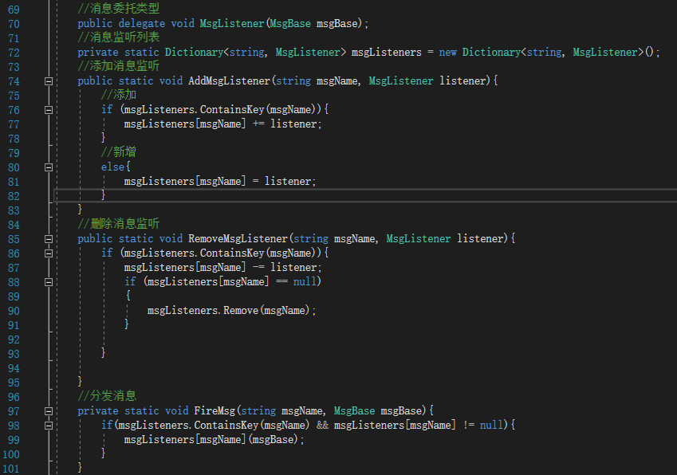
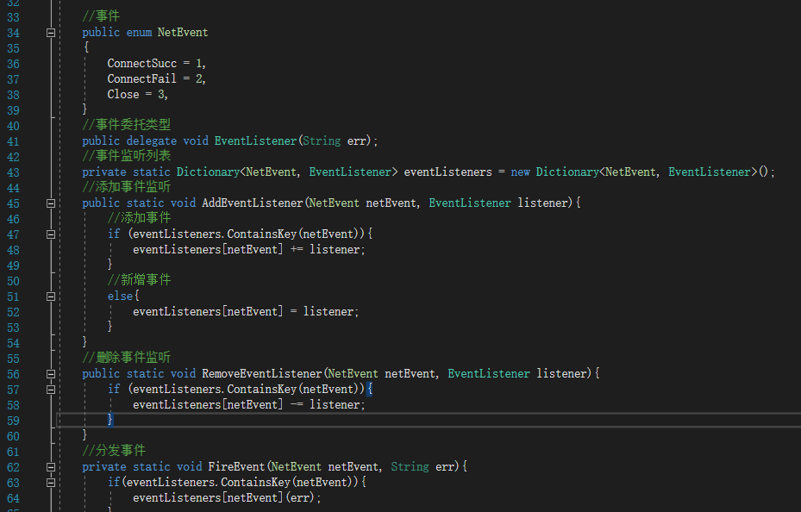
Observer Pattern

Slide 20
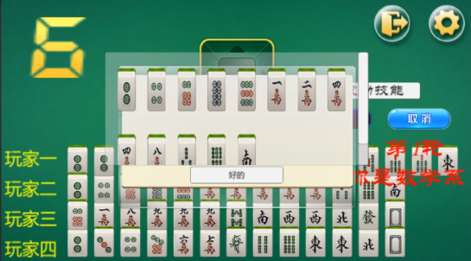
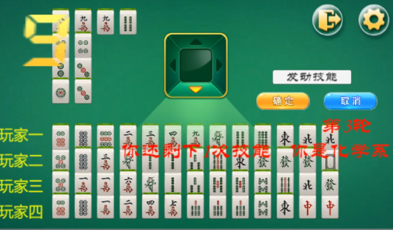
Unique Majiang rule for SUSTech
Department skills:
Department of Math:
The number of cards we can see = 14-x (number of rounds)
Department of Chemistry：
Throw one more card and take one more card

Slide 21
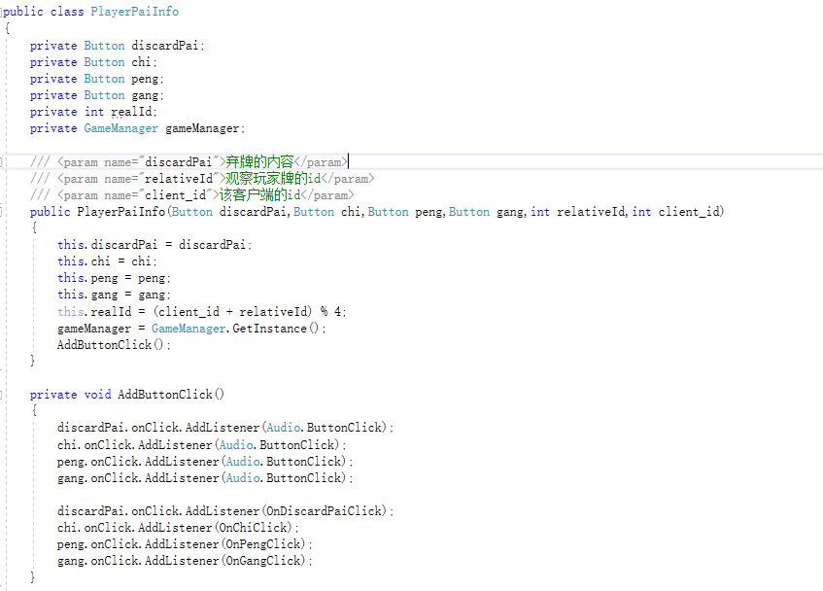
GREAT structure of our code
After refactor

Slide 22
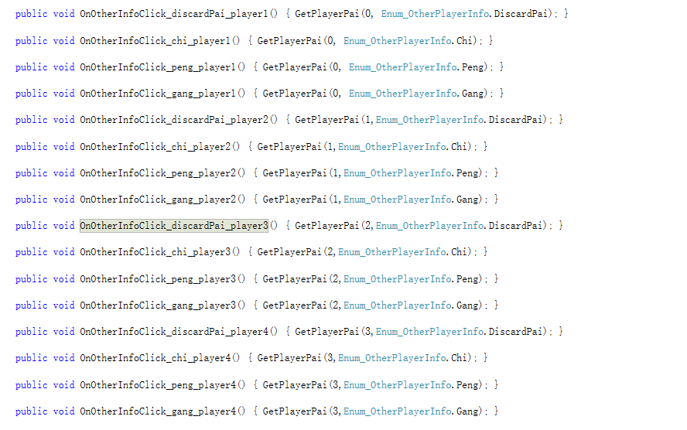
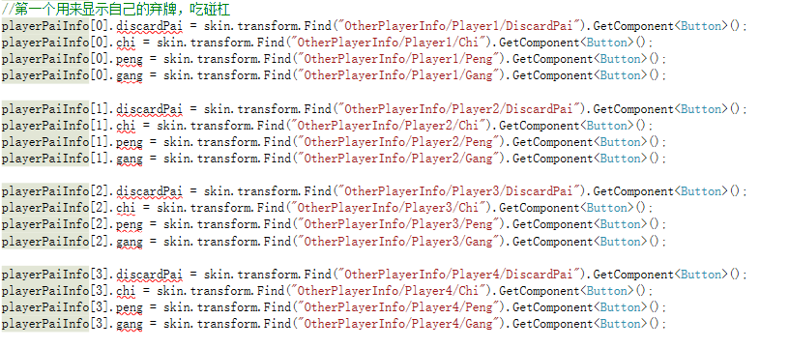
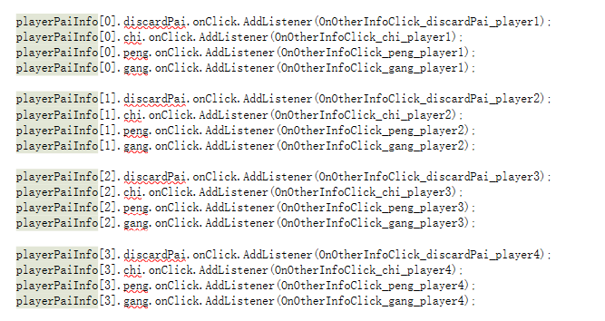
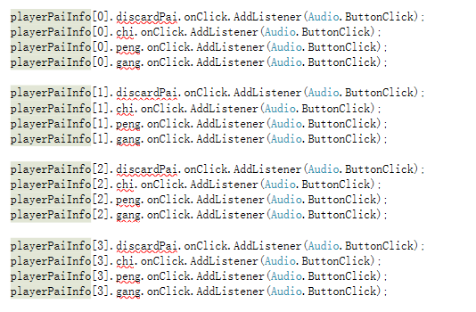
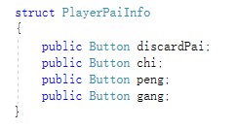
Before refactor

Slide 23
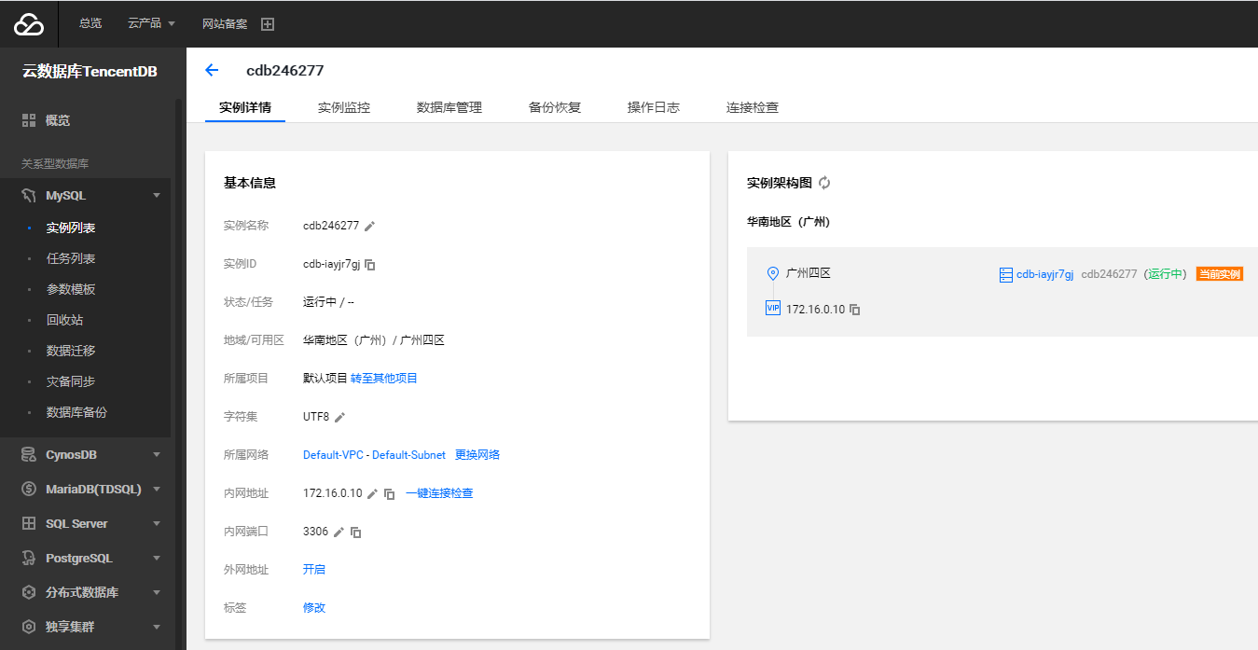
NOT ECONOMIC
Renting servers, UI costs a lot of money

Slide 24
Each team member’s responsibility
Design the rules of the game
Provide art and music resource
林傲
Client-end logic
Prepare for the Pre
向昕昊
卞证
Network framework
Server-end logic
徐天元
孙斌贤
Solve technical problems
Client-end logic
Login in function
UI design
> All members write documents of their own code part

Slide 25
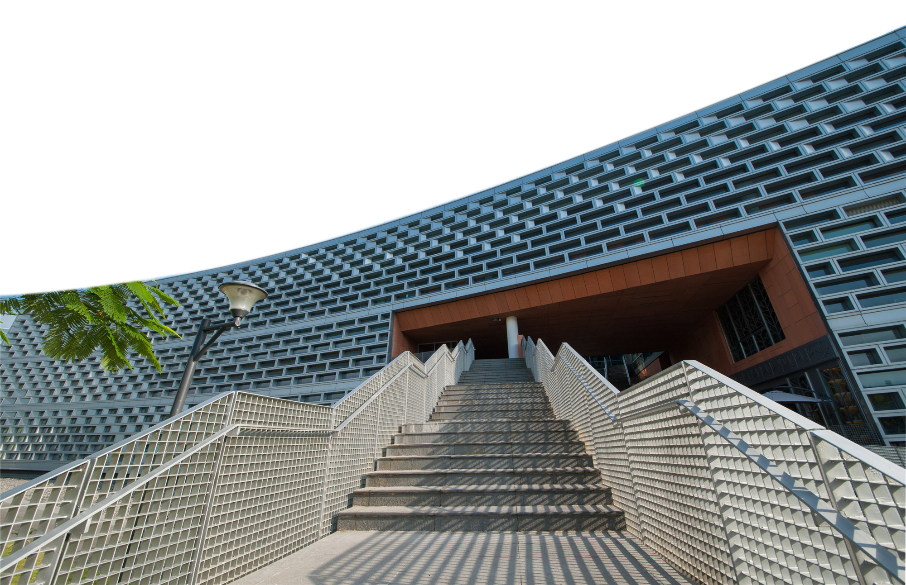
曲指搓麻二十春，观看输赢乱纷纷。静中悟得阴阳理，闲暇闲心源是真。
THANK YOU
卞证 向昕昊 徐天元 林傲 孙斌贤

